Slide 1
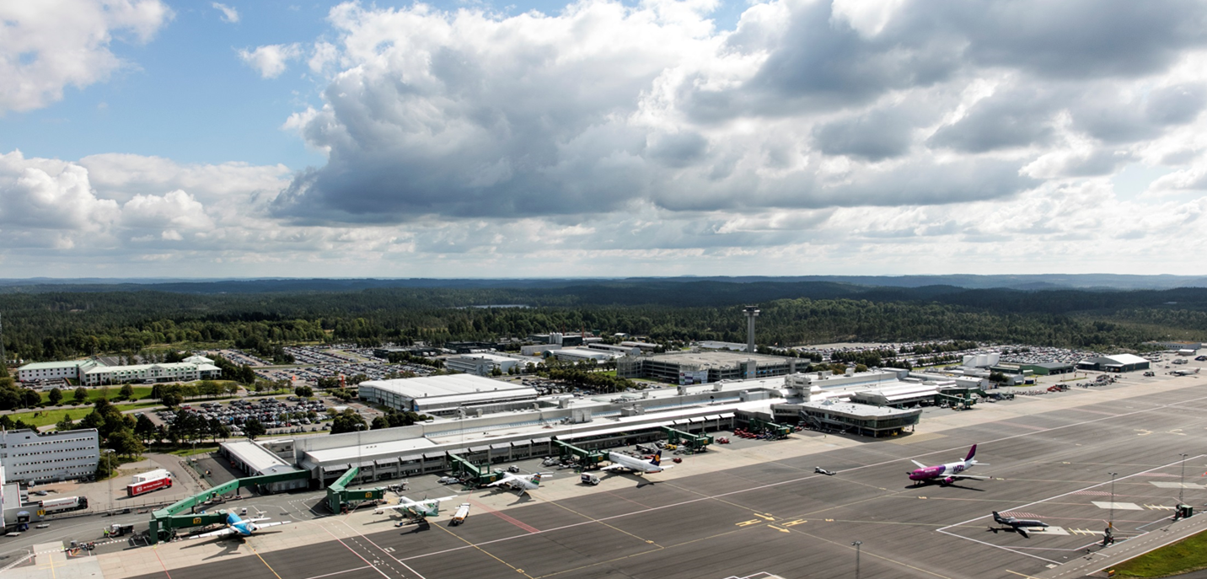
Action Plan COVID-19 Göteborg Landvetter Airport
2020-12-03

Slide 2
Local adjustments of the EASA recommendations*
Measures | Swedavia
Physical distancing
Hand hygiene, respiratory etiquette
Face masks
Health safety promotion material
Cleaning and Disinfection
Health statement | Handled by GH & airline.
Thermal screening | Handled by GH & airline. Swedavia assigns a designated area upon request.
Current standard procedure July 2020
Possible if requested
Non compliant
* COVID-19 Aviation Health Safety Protocol
https://www.easa.europa.eu/sites/default/files/dfu/EASA-ECDC_COVID-19_Operational%20guidelines%20for%20management%20of%20passengers_final.pdf

Slide 3
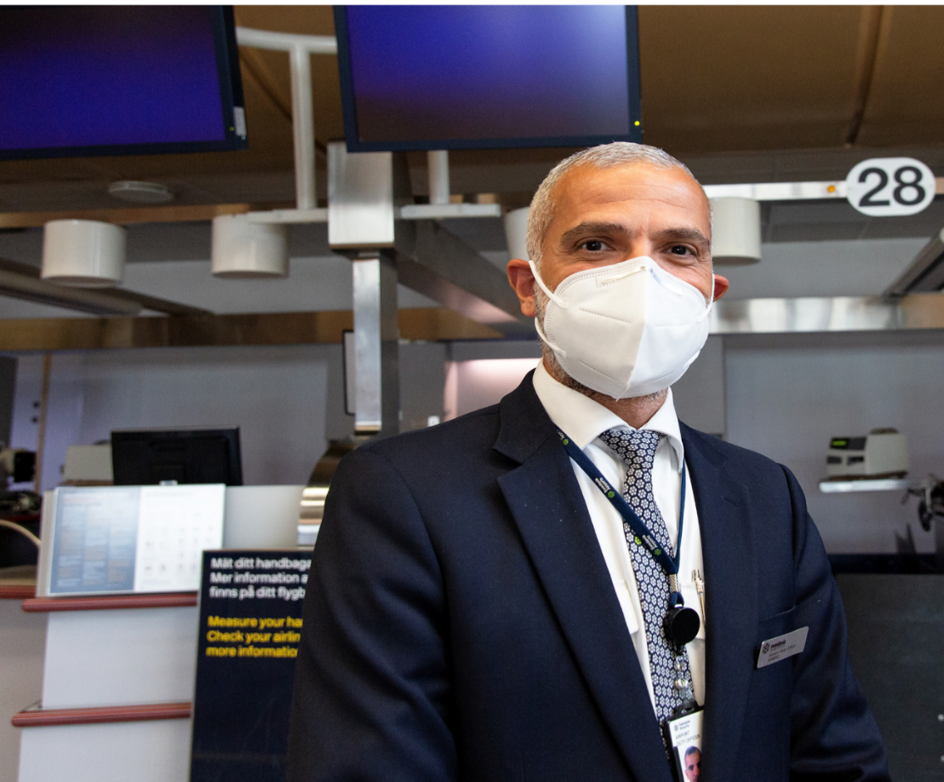
Swedavia employees – relevant protective measures are taken to protect others and each other
Swedavia is following the guidelines of the Swedish Public Health Agency:
Always stay home if you feel unwell
Ensure good hand hygiene and respiratory etiquette (cough into your elbow)
The Swedish state has taken away the unpaid first day of absence due to illness, this to prevent employees from going to work when they are sick.
Swedavia has guidelines for social distance in place:
A policy for working at home
Posters in lunch rooms and meeting rooms encouraging infection control measures
A complete consequence and risk assessment of every part of our operation has been performed for all Swedavia Airports with the help of the Stockholm County Infection Control Unit.
In mandatory passenger flows – security checkpoints, PRM (passengers with restricted mobility) and other airport services that have close contact with passengers – our employees will wear face masks.
Swedavia is producing an internal handbook for all infection control
procedures and the use of PPE (Personal Protection Equipment).
Swedavia is performing risk assessments after every new change in routines.
Enforcing social distancing in critical parts of our operations to minimise infection and secure airport operations.
Policy published on how to uphold social distancing in staff areas.

Slide 4
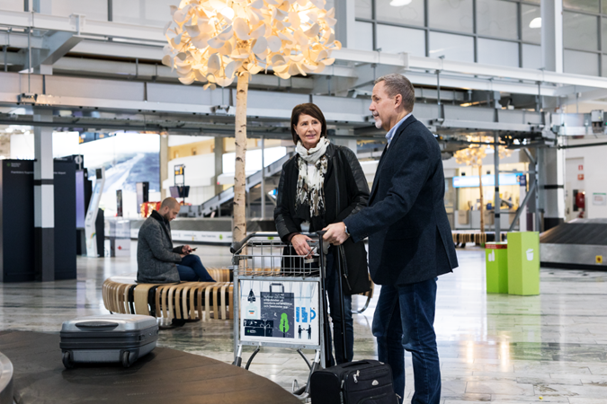
Passenger Process
Passenger process

Slide 5
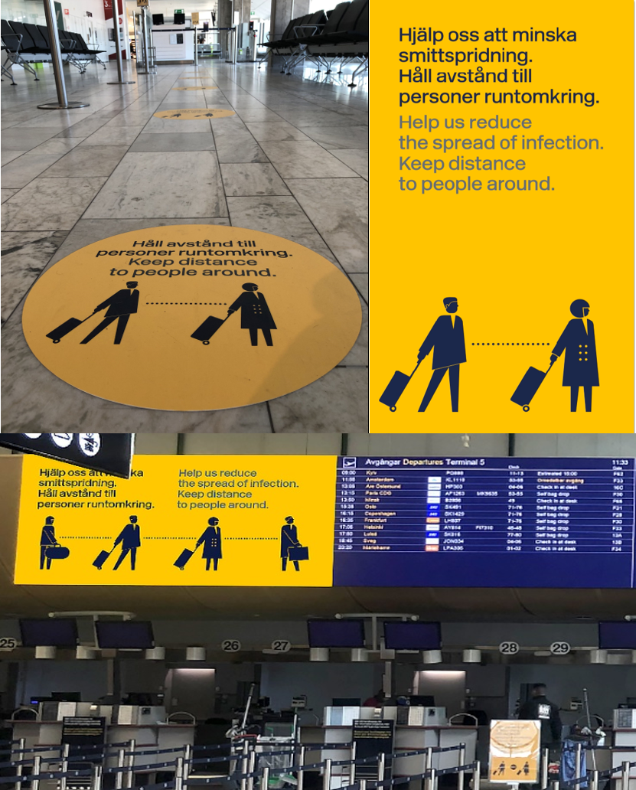
General Communication
The health and safety measures in place will be clearly communicated to our travellers and airport staff.
Passengers are encouraged via social media to check-in at home or by using Self service at the airport.
Yellow signs and floor stickers throughout the airport emphasise the need to maintain social distance.
Frequent announcements about social distancing in the terminal and use of face masks
Swedavia encourages meeters and greeters to wait outside the terminal to minimize the risk of crowding inside the terminal.

Slide 6
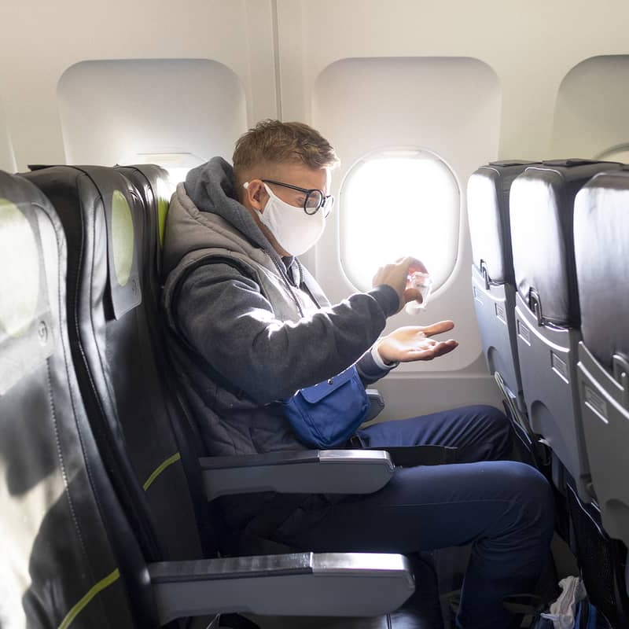
Face masks for passengers
Swedavia encourage passengers to use face masks at Göteborg Landvetter Airport.
Some airlines have implemented mandatory use of face masks to be able to board the aircraft, please see general guidelines for each airline.
Passengers will be able to purchase face mask at Göteborg Landvetter Airport, both before and after passing the security checkpoint in selected shops.

Slide 7





Safe passenger flows – from landside to the aircraft and back
Check-in
Security control
Boarding
Remote handling
Arrivals
Protective shields are installed in the check-in counters.
Yellow signs continue with floor markings in queueing zones.
Some Self Service Check-in units (CUSS) have been closed to increase the distance between passengers.
If airlines or handling agents want to include temperature screening as a measure in their procedures, this will be possible upon request to Swedavia. A specific area will be allocated in the passenger flow.
The airport provides hand sanitizer at the check-in area.
Protective sheilds are installed at the security checkpoints.
Social distancing is encouraged with the help of security staff, signage and barriers.
Special and updated procedures for manual inspection have been introduced to reduce the risk of infection.
Protective gloves are worn for manual visitations.
The airport provides hand sanitizer at the security control.
Protective sheilds are installed in boarding counters.
Yellow signs continue with floor markings in queueing zones.
Self Boarding gates are being used.
When allocating aircraft, social distancing will be taken into consideration whenever possible.
If airlines or handling agents want to include temperature screening as a measure in their procedures, this will be possible upon request to Swedavia. A specific area will be allocated in the passenger flow.
The airport provides hand sanitizer at the gate.
To allow for social distance, passengers are spread out on more buses and each bus takes fewer passengers than usual.
Protective area has been established to separate the driver from the passengers.
Cleaning routines on board airport buses.
Social distancing is encouraged with the help of Swedavia staff, digital and analogue signage and through announcements in the arrival hall.
Allocation of baggage arrival belts will be carried out with regard to social distance and passenger volumes.
To minimize queues and gatherings at the border control, more control positions will be open.
Customs control floor markings for queing distance

Slide 8
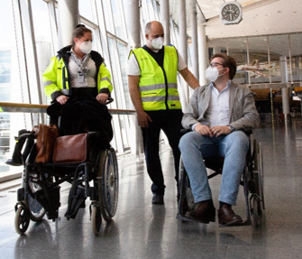
The PRM process is adjusted to reduce the risk of infection
When Covid 19 is suspected or confirmed, the assignment is handed over to the fire departement.
PRM attendants use face masks on all assignments.
PRM attendants use disposable gloves on assignments when required.
All wheelchairs are disinfected after every assignment.
Hand sanitisers and gloves have been distributed to the wheelchair storage rooms.

Slide 9
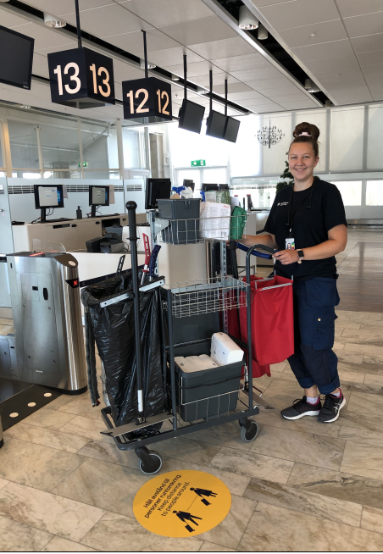
Cleaning & disinfection

Slide 10






Reinforced general hygiene measures
Contact surfaces
Cleaning frequency
Cleaning routines
Cleaning equipment
Ventilation
Cleaning staff
Contact surfaces such as door handles, handrails, Self Service machines (CUSS), elevator buttons, door openers etc. are cleaned daily.
Cleaning in security checkpoints and PVK (staff & goods).
Cleaning focus on area in use.
Swedavia ensures cleaning in accordance with the VGR County Infection Control Unit.
Mops & tablecloths are washed at a higher temperature than normal (90°C).
Established routines are reinforced and controlled by the cleaning supplier's management.
The cleaning staff uses gloves.
Mechanical cleaning in combination with bactericidal agents is used for all surfaces.
In addition to the standard according to the VGR County Infection Control Unit, there is the possibility of further customized disinfection, steam washing, machine washing and bactericides.
High-altitude cleaning including cleaning of ventilation is performed continuously.
Regular cleaning of the ventilation system and air filter.
Our cleaning staff follows the recommendations of the public health authorities.
All employees stay at home/are sent home in case of illness or suspicion thereof.
The Swedish state has taken away the unpaid first day of absence due to illness - this to prevent employees from going to work when they are sick.

Slide 11
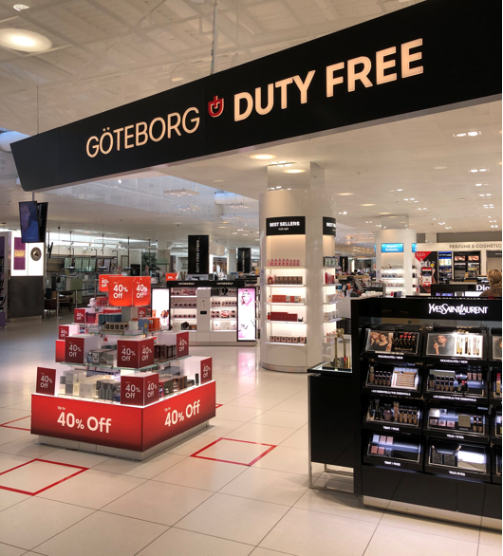
Retail, Food & Beverage

Slide 12




Creating safe environments for passengers and employees
Restaurants
Shops
Deliveries
Area limitations
Airports’ Food & Beverage units follow the guidelines and recommendations of the public health authorities.
Each operator continuously conducts an inventory of measures taken together with Swedavia.
No buffets are served.
Only table service or cash order.
Kitchen staff use gloves.
Blockage of seats or rearranging of furniture allow for social distance.
Several units offer take-away meals.
Airport retail units follow the guidelines and recommendations of the public health authorities.
Each operator continuously conducts an inventory of measures taken together with Swedavia.
The number of visitors is limited when necessary.
An upside with the central handling of goods at GOT is that it reduces the presence of external operators on the Swedavia premises.
Delivery of goods will continue to be in accordance with all applicable food hygiene regulations.
There will be an ongoing evaluation and measures will be taken to reduce contamination on surfaces such as playgrounds, seating areas and water fountains.

